Slide 1
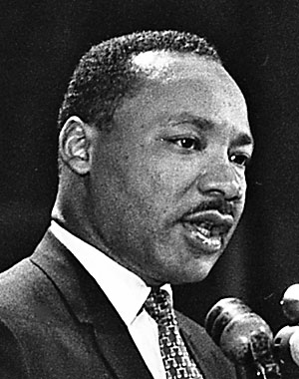
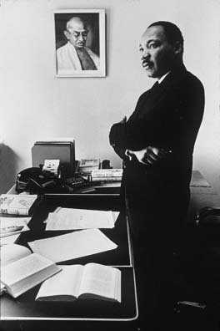
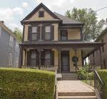
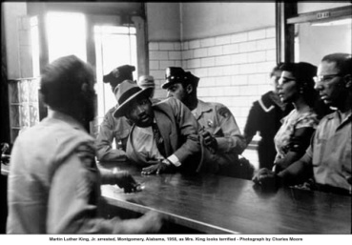
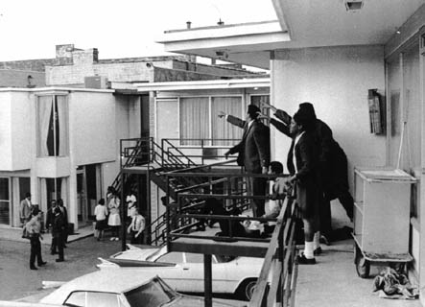
Dr. Martin Luther King, Jr.
Born on January 15, 1929. Parents: The Reverend and Mrs. Martin Luther King, Sr. Home: Atlanta, Georgia.
Martin joins the bus boycott after Rosa Parks was arrested on December 1, 1955.
Visited India to study Mohandas Gandhi's philosophy of nonviolence.
Martin arrested in Birmingham, Alabama on April 12, 1963. He wrote his Letters from Birmingham Jail at this time.
Died on April 4, 1968. Location: Memphis, Tennessee
1929
1955
1958
1963
1968
By Mr. Biggs

